Slide 1
When Neural Machine Translation Meets Conversation
Xiaodong Gu, Clova AI, NAVER
Notes:
Hi, my name is Xiaodong Gu, from Naver Clova AI. I will talk about our recent research on applying neural machine translation to conversation systems.

Slide 2
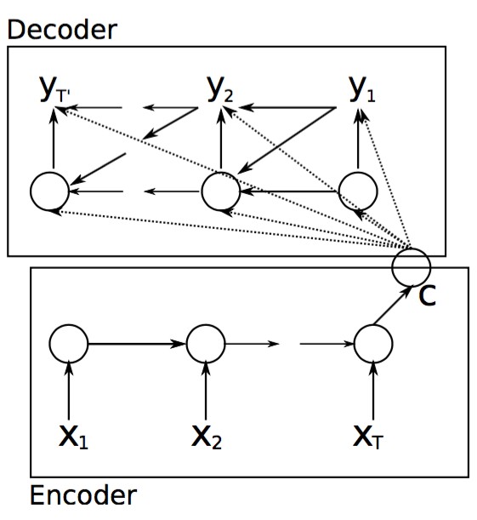
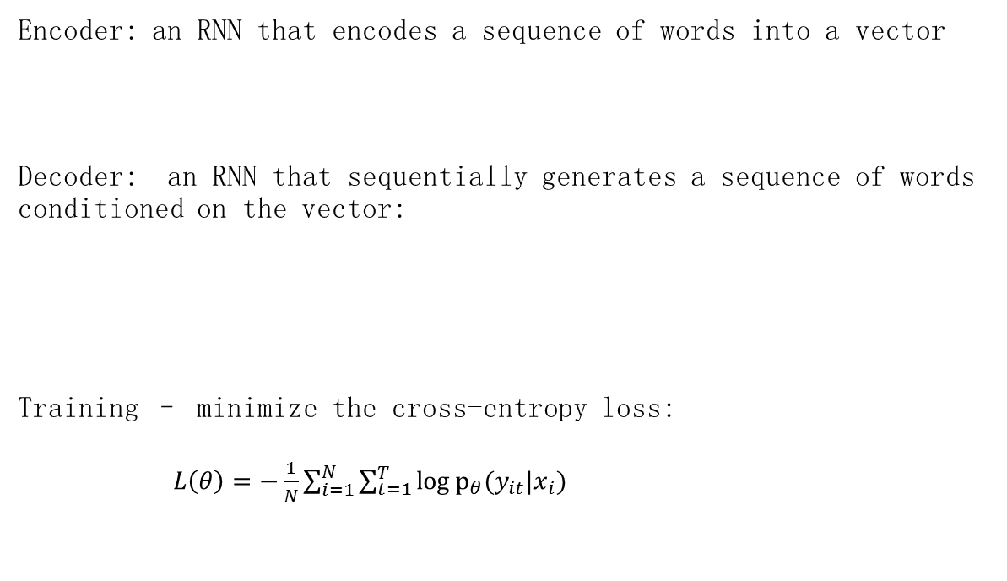
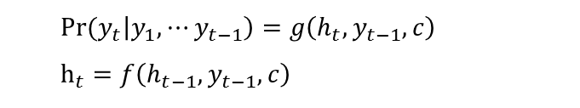
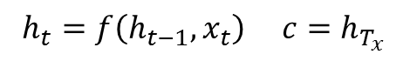
Sequence-to-Sequence Learning
[Cho et al. 2014]
Encoder: an RNN that encodes a sequence of words into a vector
Decoder: an RNN that sequentially generates a sequence of words conditioned on the vector:
Training – minimize the cross-entropy loss:
$L\left(θ\right)=−\frac{1}{N}\sum_{i=1}^{N}{\sum_{t=1}^{T}{\log{p_{θ}(y_{it}|x_{i})}}}$
$h_{t}=f\left(h_{t−1},x_{t}\right)$ $c=h_{T_{x}}$
$${Pr⁡(y}_{t}\left|y_{1},⋯y_{t−1}\right)=g\left(h_{t},y_{t−1},c\right)$$
$$h_{t}=f\left(h_{t−1},y_{t−1},c\right)$$
Notes:
So let’s start from the sequence to sequence model, the basic model for neural machine translation. The model contains two components: an encoder and a decoder, ….

Slide 3
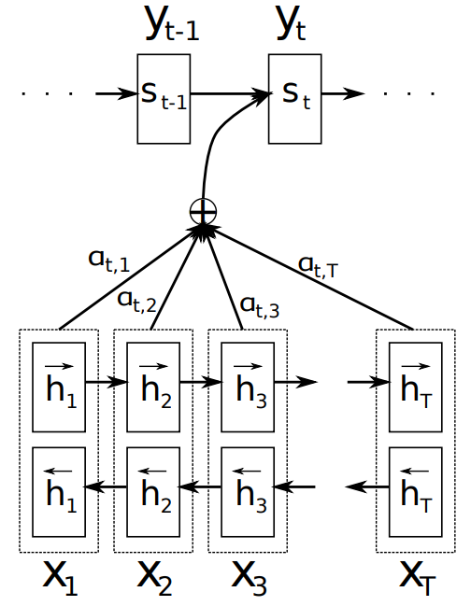
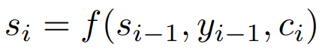
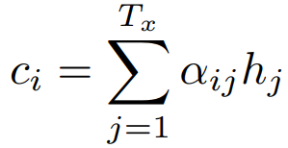
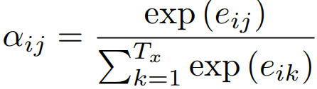
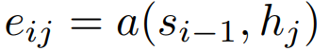
Sequence-to-Sequence with Attention
[Bahdanau et al. 2014]
Notes:
There have been many variants since the basic seq2seq model was proposed. The most popular one is the attention based seq2seq..

Slide 4
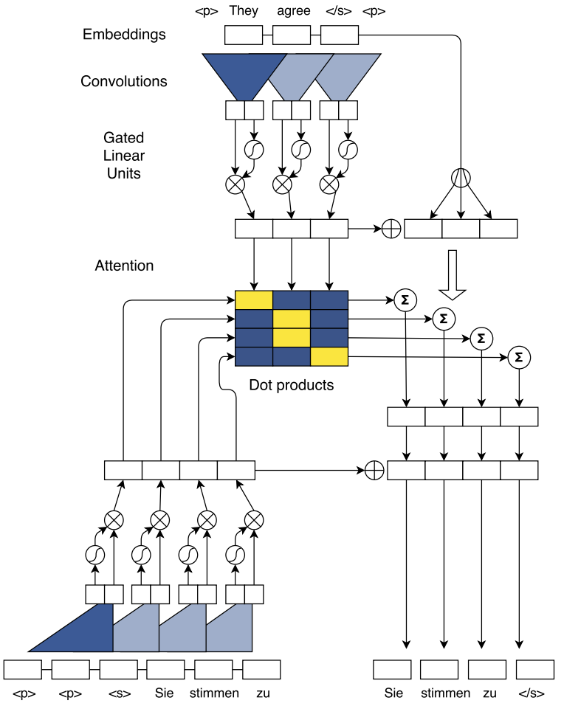
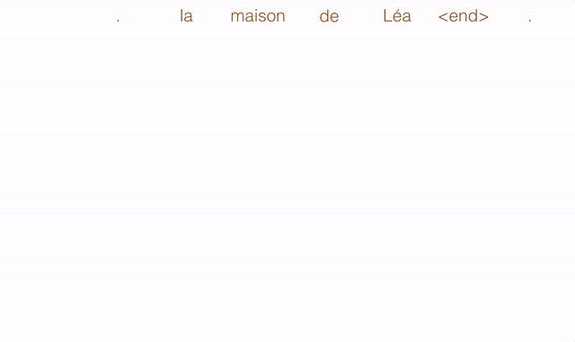
Convolutional Sequence-to-Sequence
[Gehring et al. 2015]
Notes:
Besides RNN, we also have CNN based sequence-to-sequence which uses CNNs as the encoder and decoder and is much easier for parallelism.

Slide 5
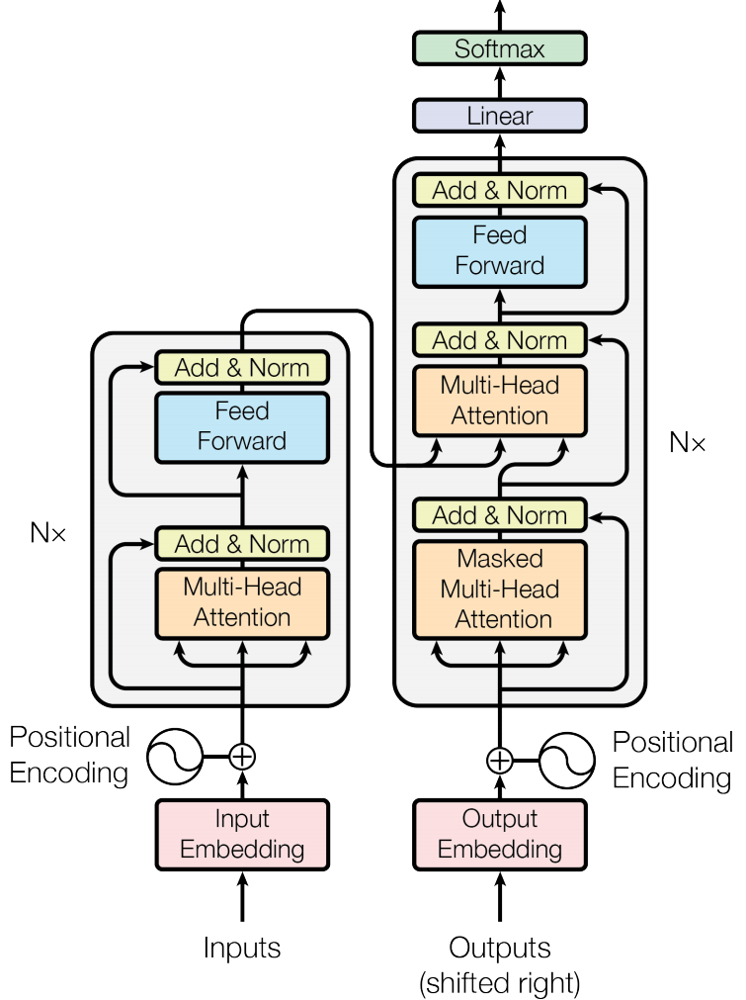
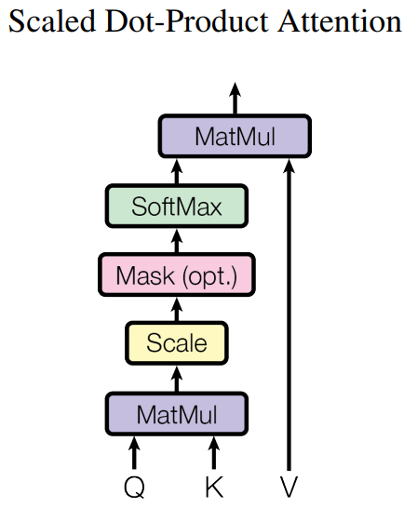

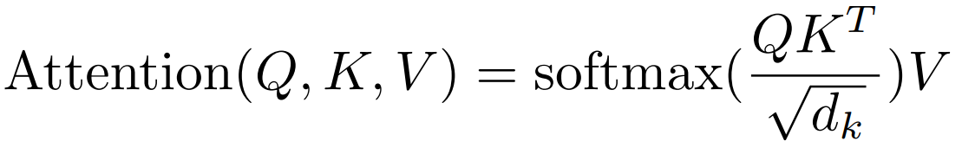
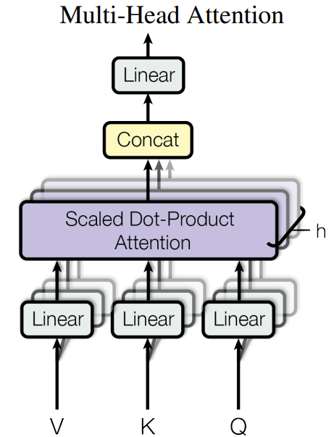
Transformer -“Attention is all you need”
[Vaswani et al. NIPS2017]
Notes:
And now, a popular architecture is transformer, which is purely built on the attention model..

Slide 6
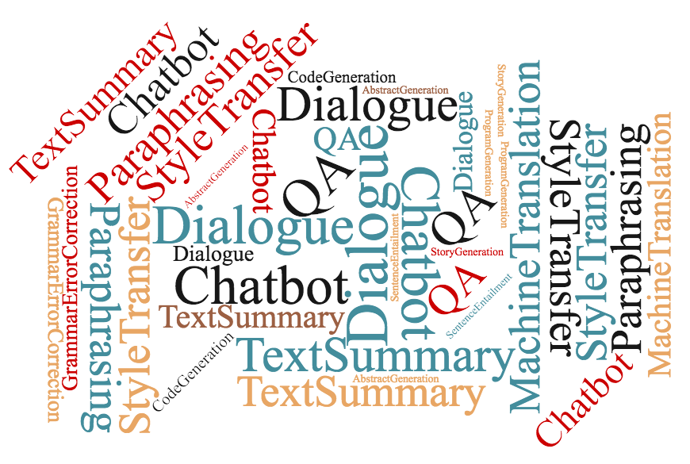
Applications of Sequence-to-Sequence Learning
Notes:
As we know, the seq2seq model was originally designed for neural machine translation. But it has been widely used in many other NLP tasks such as Chatbots, QA, paraphrasing, style transfer, etcetera.
https://www.wordclouds.com/
15 MachineTranslation
12 MachineTranslation
11 MachineTranslation
11 Dialogue
10 Dialogue
10 Chatbot
10 Chatbot
10 QA
9 TextSummary
9 Dialogue
9 QA
8 MachineTranslation
8 StyleTransfer
8 StyleTransfer
8 StyleTransfer
8 StyleTransfer
8 Paraphrasing
8 Paraphrasing
8 Paraphrasing
8 TextSummary
8 Chatbot
8 QA
7 TextSummary
7 Chatbot
6 MachineTranslation
6 TextSummary
6 Chatbot
6 QA
5 Dialogue
4 GrammarErrorCorrection
4 GrammarErrorCorrection
4 Dialogue
3 CodeGeneration
3 CodeGeneration
2 AbstractGeneration
2 SentenceEntailment
2 SentenceEntailment
2 AbstractGeneration
2 AbstractGeneration
2 ProgramGeneration
2 ProgramGeneration
2 StoryGeneration
2 StoryGeneration

Slide 7
This Talk
Recent research on adapting sequence-to-sequence for dialogue generation
“DialogWAE: multimodal response generation with conditional Wasserstein auto-encoder” (to be appear at ICLR 2019)
Notes:
In this talk, I will introduce our recent research on open-domain dialogue generation. DialogWAE. The paper is going to be appear at ICLR this year.

Slide 8
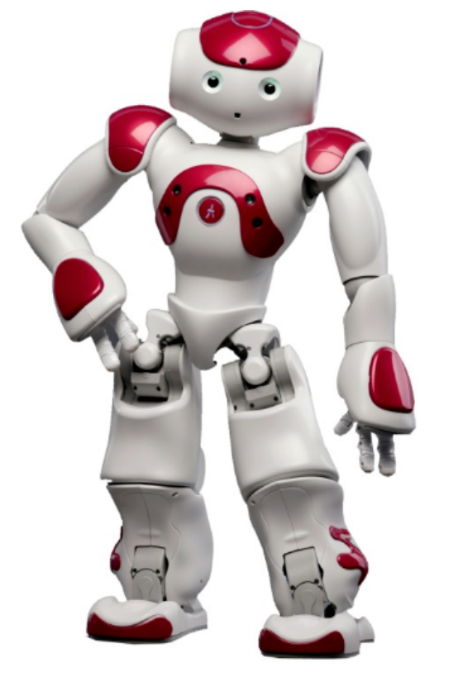
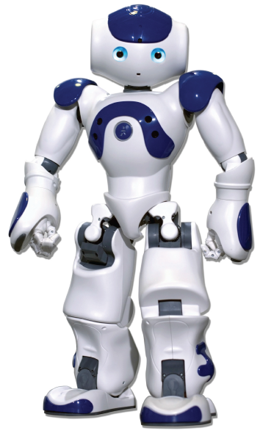
Open-domain Dialogue Generation
context
How are you?
Good!
How was the weather in your city?
Good!
How was the weather in your city?
I do not know
next utterance
Notes:
Open domain dialogue means chitchat between human or chatbots. For example, here are two chatbots, one may ask … The goal of open domain dialogue generation is to predict the next utterance given a dialogue history. We can easily model this conversation using sequence to sequence learning.

Slide 9
Challenges of the Naïve Seq2Seq for Dialogue Modeling
How is the weather?
Good
I don’t know
Why not ask her?
How are you?
Hesitating among different ground truths
Favoring generic, safe responses (e.g.,“good”, “I don’t know”)

Slide 10
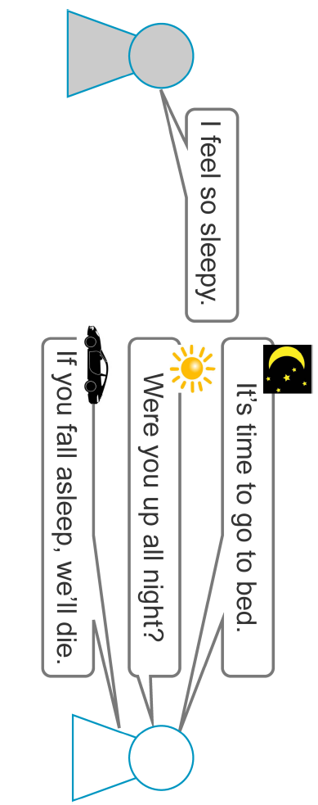
Consider Situations
Notes:
To resolve this problem, Let’s think about why there are multiple responses. …
One idea is to decode the responses conditioned on different situations, then the model will not hesitate among different ground truths.

Slide 11
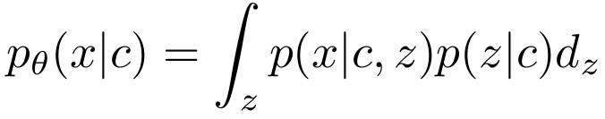
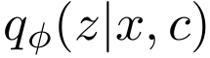
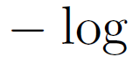
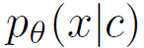

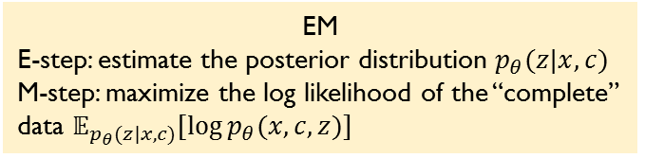
Problem Statement
z–situations, topics, etc
c–context x–response
Conditional VAE: Approximate the posterior z as which can be represented as a NN.
ELBO of Conditional VAE
EM
E-step: estimate the posterior distribution $p_{θ}(z|x,c)$
M-step: maximize the log likelihood of the “complete” data $𝔼_{p_{θ}(z|x,c)}[\log{p_{θ}(x,c,z)}]$
Intractable
encoder
decoder
Notes:
Let’s formulate the idea.

Slide 12
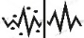
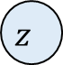
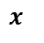
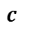
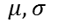
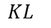
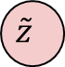
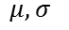
CVAE – Learning a latent representation of the response
[Zhao et al. ACL’17]
$$x$$
Recognition Network
$$μ,σ$$
I
like
baseball
$$z$$
I
like
baseball
<s>
I
like
$$KL$$
utterance encoder
I
like
football
0
Prior Network
$$μ,σ$$
$$\tilde{z}$$
context encoder
that
is
cool
1
response decoder
$$c$$
conversation floor
0/1
what
about
you
0
Limitations:
z is forced to a simple form (e.g., Gaussian)
possible mode collapse
posterior collapse – strong decoder prevents the latent variables to be exploited
Notes:
This results in a baseline model, the CVAE model.

Slide 13
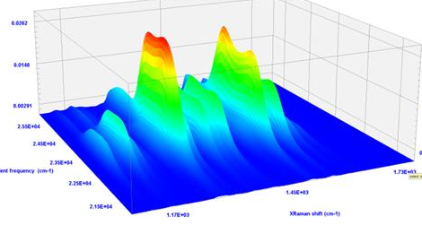
Multimodal Prior
How is the weather?
good
I don’t know
Response(x)
Situation (z)
Context (c)

Slide 14
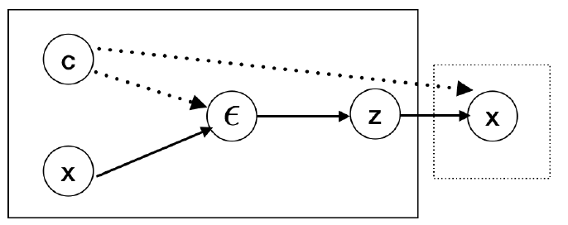
DialogWAE–a GAN model to“generate”the latent variable
W
Discriminator
Generator
Notes:
So our idea is: instead of sampling a latent variable from a simple gaussian distribution, we can generate these latent variables.

Slide 15
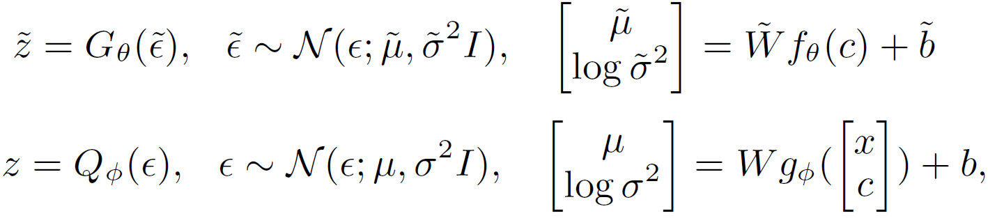
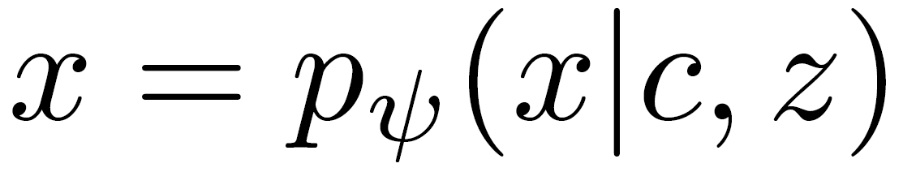
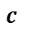
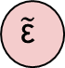
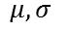
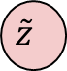
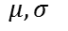
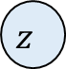
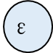
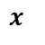
DialogWAE
$$x$$
Recognition Network
$$μ,σ$$
I
like
tennis
$$\text{ε}$$
Q
$$z$$
I
like
tennis
<s>
I
like
D
I
like
soccer
0
utterance encoder
Prior Network
$$μ,σ$$
$$\tilde{\text{ε}}$$
G
$$\tilde{z}$$
context encoder
that
is
cool
1
$$c$$
response decoder
0/1
conversation floor
what
about
you
0
[Recognition Network]
[Prior Network]
[decoder]
Notes:
To resolve this problem, Let’s think about why there are multiple responses. …
So one idea to this problem is to decode the responses conditioned on different situations, then the model will not hesitate among different ground truths.

Slide 16

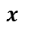
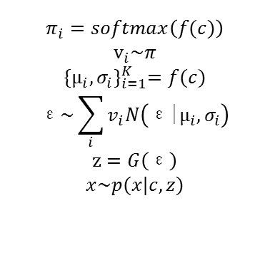
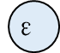
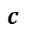

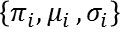
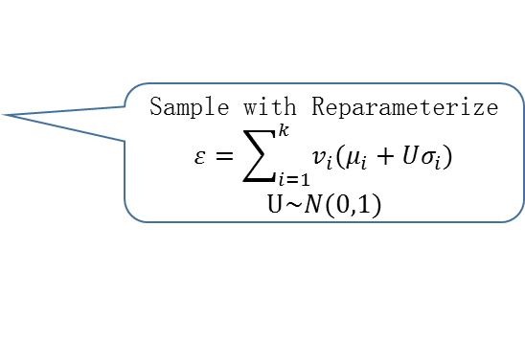



DialogWAE with Gaussian Mixture Prior
$$π_{i}=softmax\left(f(c)\right)$$
$$v_{i}\sim π$$
$${\{μ_{i}, σ_{i}\}}_{i=1}^{K}=f(c)$$
$$\text{ε}\sim \sum_{i}{v_{i}N\left(\text{ε}\text{|}μ_{i},σ_{i}\right)}$$
$$\text{z}=G\left(\text{ε}\right)$$
$$x\sim p(x|c, z)$$
Sample with Gambul-softmax
$$v_{i}=softmax(\frac{f\left(c\right)+g}{τ})$$
Sample with Reparameterize
$$ε=\sum_{i=1}^{k}{v_{i}(μ_{i}+Uσ_{i})}$$
$$U\sim N(0,1)$$
topic1
topic2
$$x$$
Recognition Network
$$μ,σ$$
I
like
baseball
$$\text{ε}$$
Q
$$z$$
I
like
baseball
<s>
I
like
D
I
like
football
$$\left\{π_{i}{,μ}_{i},σ_{i}\right\}$$
utterance encoder
0
Prior Network
$$\tilde{\text{ε}}$$
G
$$\tilde{z}$$
context encoder
that
is
cool
1
$$c$$
response decoder
0/1
conversation floor
what
about
you
0

Slide 17

Training

Slide 18


Experimental Results

Slide 19

Example

Slide 20

Thanks!
Notes:
That’s all of my talk and thanks! You can check out our repository by scanning the QR code.

